Slide 1


Data, AI
& Python
INTERACTIVE LECTURE · BEGINNER LEVEL
A friendly first look at statistics, artificial intelligence, machine learning and Python.
1 · Statistics
2 · AI
3 · Machine Learning
4 · Python

Slide 2
Today’s roadmap
WELCOME
1
2
3
Statistics
AI
Machine Learning
Data types, centre, spread and graphs
What AI is, and where we meet it every day
How machines learn, and preparing data

Slide 3



What is statistics?
PART 1 · STATISTICS
Statistics is the science of collecting, organising and understanding data, so we can make better decisions.
Identify patterns
Sales rise every December.
Make decisions
Which medicine works better?
Think: where did you meet statistics today? Weather, cricket scores, exam results…
Replace guessing
Test ideas with evidence.
Part 1 · Statistics

Slide 4
Introduction to data
PART 1 · STATISTICS
TYPE 1 – Qualitative Data
TYPE 2 - Quantitative Data
Categorical data
Numerical data
Labels or groups: words, not amounts.
Amounts you can measure, count and add up.
Favourite colour
City
Grade (A, B, C)
Height
Exam marks
Age
Rule of thumb: you can average numerical data, but not categorical data.
Part 1 · Statistics

Slide 5
Two kinds of Quantitative data
PART 1 · STATISTICS
DISCRETE
CONTINUOUS
Counted in whole numbers
Measured on a scale
Separate values: 0, 1, 2, 3 … nothing in between.
Any value in a range, such as 170.5 cm or 170.52 cm.
Pets at home
Siblings
Languages spoken
Height
Weight
Blood pressure
Examples:
Number of students in a class: 30
Number of books: 5
Number of cars: 3
Number of siblings: 2
Examples:
Height: 5.7 feet
Weight: 62.5 kg
Temperature: 36.6°C
Distance: 12.75 km
Part 1 · Statistics

Slide 6
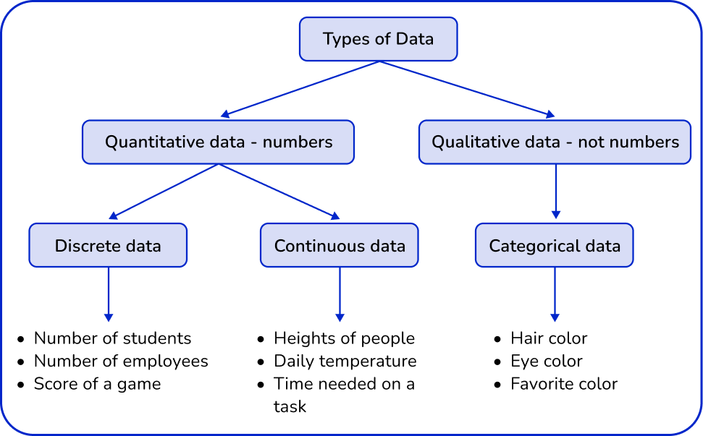
Types of data
PART 1 · STATISTICS
Part 1 · Statistics

Slide 7

What is data summarization?
PART 1 · THE BASICS
DEFINITION
Data summarization means describing a large dataset with a few numbers, tables or graphs that capture its main features.
1,000 exam marks
One summary
58, 91, 73, 66, 84, 79 …
Average 72
Part 1 · The basics
Notes:
Pause on the question at the bottom and take answers. A summary loses some detail on purpose so that a human can understand the data quickly. The rest of the lecture is about choosing good summaries.

Slide 8
Dataset, observation, variable
PART 1 · THE BASICS · VOCABULARY
A SMALL DATASET
Dataset
Student | Hours studied | Passed
Ali | 4 | Yes
Sam | 6 | Yes
Zoya | 2 | No
Omar | 5 | Yes
The whole table of collected data.
Observation/ Record
One row: one person, item or event. Zoya is one observation.
Variable
One column: a characteristic that can change. “Hours studied” is a variable.
Part 1 · The basics
Notes:
Point at the table: rows are observations, columns are variables, and the whole table is the dataset. This table has 4 observations and 3 variables. Ask: how many observations and variables would a class register have? Remember a variable is called a variable because its value varies from row to row.

Slide 9



Three questions about any numbers
PART 2 · SUMMARIZING NUMBERS
Centre
Spread
Position
Where is the middle?
How far apart are the values?
Where does one value sit?
Mean, median, mode
Range, standard deviation, IQR
Percentiles, quartiles
A good summary answers all three. The centre alone can hide a lot.
Part 2 · Summarizing numbers
Notes:
This is the map for the next six slides. Centre, then spread, then position. Use the example of two classes with the same average mark but one very mixed: the centre is equal, the spread is not.

Slide 10
Mean, median and mode
PART 1 · STATISTICS
2, 3, 3, 5, 7
OUR DATA
Mean
Median
Mode
Mean is the average of a set of numbers. It is calculated by adding all the values together and dividing the sum by the total number of values.
Median is the middle value in a set of numbers when the numbers are arranged in ascending or descending order.
Mode is the value that appears most frequently in a set of numbers.
3 appears twice
(2+3+3+5+7) ÷ 5
2, 3, 3, 5, 7
= 3
= 3
= 4
Part 1 · Statistics

Slide 11
Mean or median?
PART 2 · CENTRE · CLICK TO SEE WHAT HAPPENS
MONTHLY PAY IN A SMALL TEAM (THOUSAND)
THE BOSS JOINS, EARNING 200
30, 32, 35, 38, 40
30, 32, 35, 38, 40, 200
Mean 35 · Median 35
Mean 62.5 · Median 36.5
Balanced data: both agree.
One extreme value drags the mean up. The median barely moves.
Definition: an outlier is a value that lies far away from the rest of the data. Rule: use the median when outliers are present.
Part 2 · Centre
Notes:
Ask first: what happens to the mean and the median if the boss joins the team? Then click. Sum of the first five is 175 so the mean is 35. With 200 added the sum is 375 and 375 divided by 6 is 62.5. The median of the six sorted values is (35 plus 38) divided by 2, which is 36.5. Which one describes a typical employee better? The median.

Slide 12

Mean, median and mode
PART 1 · STATISTICS
2, 4, 6, 8
OUR DATA
Mean
Median
import numpy as np
a = np.array([2, 4, 6, 8])
print(a.mean())
import numpy as np
a = np.array([2, 4, 6, 8])
print(np.median(a))
Part 1 · Statistics

Slide 13
Find the mean, median and mode
Activity
4, 6, 6, 8, 11
MEAN
MEDIAN
MODE
7
6
6
35 ÷ 5
The middle of 5 sorted values
It appears twice
Part 1 · Statistics

Slide 14
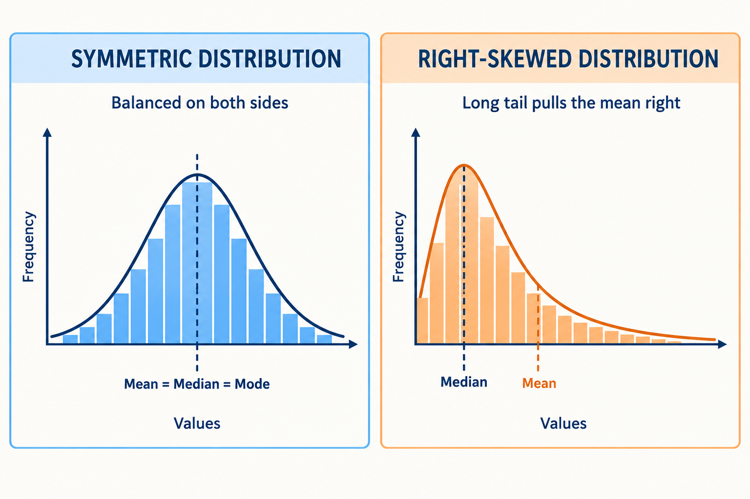
Mean or median?
PART 1 · STATISTICS
SALARIES IN A SMALL TEAM
THE BOSS JOINS (200)
30, 32, 35, 38, 40
30, 32, 35, 38, 40, 200
Mean 35 · Median 35
Mean 62.5 · Median 36.5
Balanced data: both agree.
One extreme value drags the mean up.
Symmetric data: the mean is a fine summary.
Skewed data or outliers: use the median.
Part 1 · Statistics
Notes:
Skewed data means data that is not evenly balanced. Most values are on one side, while a few unusual values stretch the data to the other side.

Slide 15


Spread
PART 1 · STATISTICS
Spread means how far apart the data values are from each other.
Small spread: Values are close together.
Large spread: Values are far apart.
Class A marks
Class B marks
68, 70, 72
50, 70, 90
Mean 70 · tightly packed
Mean 70 · widely spread
Same mean, very different data. The mean alone does not tell the whole story.
Range = max − min
A: 72 − 68 = 4 · B: 90 − 50 = 40
Part 1 · Statistics
Notes:
Simple meaning: Two sets of data can have the same mean (average) but very different spreads.
Data A: Values are close together. Range = 72 − 68 = 4.
Data B: Values are far apart. Range = 90 − 50 = 40.
Range = Maximum value − Minimum value
Key point: The mean tells us the average, while the range tells us how spread out the data is.

Slide 16
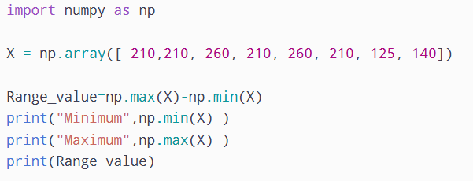
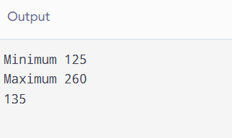
Python Range
PART 1 · STATISTICS
Part 1 · Statistics
Notes:
Skewed data means data that is not evenly balanced. Most values are on one side, while a few unusual values stretch the data to the other side.

Slide 17
Standard deviation
PART 1 · STATISTICS
Standard deviation (SD) tells you how far the values are usually spread out from the mean (average).
1
2
Subtract the mean from each value
3
Find the mean
Square each difference
4
5
6
Add them up
Divide by n − 1
Take the square root
Small SD = values close to the mean. Big SD = values far from the mean.
Part 1 · Statistics

Slide 18
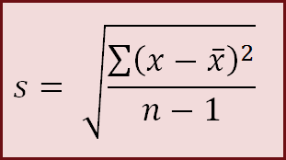
Standard deviation of 2, 4, 6, 8, 10
PART 1 · STATISTICS · EXAMPLE
Value | Minus mean (6) | Squared
2 | −4 | 16
4 | −2 | 4
6 | 0 | 0
8 | 2 | 4
10 | 4 | 16
Mean = 30 ÷ 5 = 6
Sum of squares = 40
40 ÷ (5 − 1) = 10
SD = √10 ≈ 3.16
Part 1 · Statistics

Slide 19
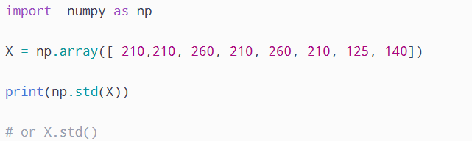
Calculate Standard deviation
PART 1 · STATISTICS · EXAMPLE
Part 1 · Statistics

Slide 20
Percentiles and quartiles
Splits the data into four parts
Arrange data in order
The median is the second quartile, Q₂
Q₁ is the median of the lower half of the observations
Q₃ is the median of the upper half of the observations
PART 1 · STATISTICS
Percentile means the percentage of values that are below a certain value.
25% of data
25% of data
25% of data
25% of data
Min
Q1 · 25th
Median · 50th
Q3 · 75th
Max
Percentile: the 80th percentile means 80% of values are at or below it.
Quartiles: Q1 = 25th, Q2 = median = 50th, Q3 = 75th percentile.
Part 1 · Statistics
Notes:
Percentile means the percentage of values that are below a certain value.
Example: If you are in the 80th percentile, you scored higher than about 80% of people.

Slide 21

Measure of Spread: Quartiles
PART 1 · STATISTICS
Quartiles divide a ranked data set into four equal parts:
Q₁= first quartile = 2.2
25% of the data at or below Q₁ and 75% above
50% of the data are above the median and 50% are below
M = median = 3.4
75% of the data at or below Q₃ and 25% above
Q₃= third quartile = 4.35
Part 1 · Statistics
Notes:
Easy trick to remember:
Q1 = middle of the lower half.
Q2 = middle of all the numbers.
Q3 = middle of the upper half.d

Slide 22
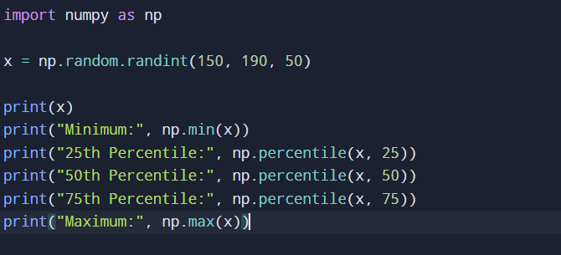
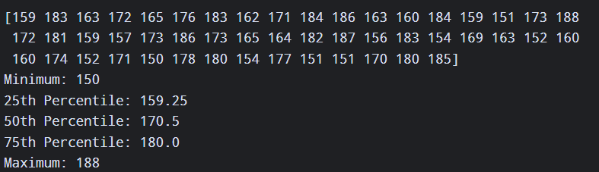
Measure of Spread: Quartiles
PART 1 · STATISTICS
The five-number summary of a
dataset consists of:
Minimum value
First Quartile
Median
Third Quartile
Maximum value
Part 1 · Statistics
Notes:
Easy trick to remember:
Q1 = middle of the lower half.
Q2 = middle of all the numbers.
Q3 = middle of the upper half.d

Slide 23
Summarize data using series
import pandas as pd
marks = pd.Series([4, 6, 6, 8, 11])
Print(marks.describe())
fruit = pd.Series(["apple", "banana", "apple"])
fruit.value_counts()
OUTPUT OF DESCRIBE()
count 5.00
mean 7.00
std 2.65
min 4.00
25% 6.00
50% 6.00
75% 8.00
max 11.00
describe() gives count, mean, SD, min, quartiles and max. value_counts() counts categories.
Notes:
One line replaces all the hand calculations from this lecture. The numbers match: mean 7, median (the 50% row) 6, minimum 4, maximum 11. Pandas std uses n minus 1, so 2.65 is the sample standard deviation. value_counts on text data gives apple 2 and banana 1. Try it in Google Colab with your own marks.

Slide 24
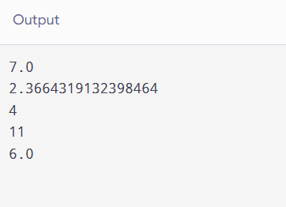
Summarize data using array
import numpy as np
marks = np.array([4, 6, 6, 8, 11])
print(np.mean(marks))
print(np.std(marks))
print(np.min(marks))
print(np.max(marks))
print(np.median(marks))
OUTPUT
Notes:
One line replaces all the hand calculations from this lecture. The numbers match: mean 7, median (the 50% row) 6, minimum 4, maximum 11. Pandas std uses n minus 1, so 2.65 is the sample standard deviation. value_counts on text data gives apple 2 and banana 1. Try it in Google Colab with your own marks.

Slide 25
Data summarization
RECAP
Term | Meaning
Data summarization | Describing a large dataset with a few numbers, tables or graphs
Mean · Median · Mode | Average · middle value · most frequent value
Range · SD | Max minus min · typical distance from the mean
Quartiles · IQR | 25th, 50th, 75th percentiles · Q3 minus Q1
Outlier | A value far away from the rest of the data
Frequency | How many times a category appears
Notes:
Go through the table term by term and ask students to say each meaning in their own words before you reveal it. Set the take-home task: pick a small dataset (marks, steps per day, prices) and summarize it with the numbers, a graph and a describe call in Python.

Slide 26
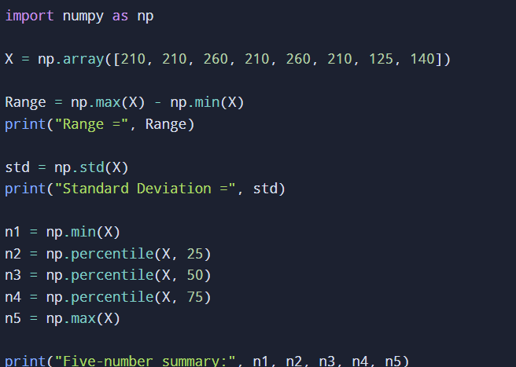
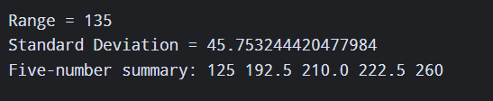
Student Task
Write a Python program using NumPy for the array X = np.array([210, 210, 260, 210, 260, 210, 125, 140]) to calculate and print the range, standard deviation, and five-number summary (minimum, 25th percentile, median, 75th percentile, and maximum).

Slide 27
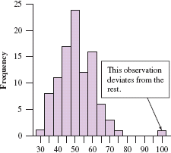
Outliers
PART 1 · STATISTICS
An outlier is a value that falls far away from the rest of the data.
Data: 2, 3, 4, 5, 6, 30
Here, 30 is an outlier because it is much higher than the other values.
Another example: Students’ marks are 65, 68, 70, 72, 75, 10.
Here, 10 may be an outlier because it is much lower than the other marks.
Part 1 · Statistics

Slide 28


Boxplot: the five numbers as a picture
PART 1 · GRAPHS
Min
Q1
Median
Q3
Outlier
0
5
10
15
20
25
30
Box: the middle 50% of data, from Q1 to Q3.
Line in the box: the median.
Part 1 · Graphs
Notes:
This is the same dataset: 2, 4, 5, 7, 9, 11, 12, 30. The box runs from Q1 (4.5) to Q3 (11.5) with the median line at 8. The right whisker stops at 12, the largest value that is not an outlier, and 30 is drawn as a separate dot. Boxplots are great for comparing several groups side by side, though a histogram shows the shape better.

Slide 29
Describing categories: frequency tables
PART 1 · STATISTICS
11 STUDENTS PICK A FRUIT
apple · apple · banana · orange · apple · apple · banana · banana · orange · banana · apple
Fruit | Count | Proportion | Percent
Apple | 5 | 0.45 | 45%
Banana | 4 | 0.36 | 36%
Orange | 2 | 0.18 | 18%
Total | 11 | 1.00 | 100%
Proportion = count ÷ total
5 ÷ 11 = 0.45
Percent = proportion × 100
0.45 × 100 = 45%
The mode of this data is apple: it appears most often.
Part 1 · Statistics

Slide 30
Reading a graph
PART 1 · STATISTICS
Favourite subject (class of 30)
12
Pick the right graph
9
Graph | Use it to
Bar chart | Compare groups
Line graph | Show change over time
Histogram | Show how values spread
5
4
Maths
Science
English
Art
Part 1 · Statistics
Notes:
Read the bar chart together: title, labels, heights. The tallest bar is Science with 12 students, so Science is the mode. Then show how each of the four graph types answers a different question. Ask which graph they would use to show temperature across a week (line graph).

Slide 31
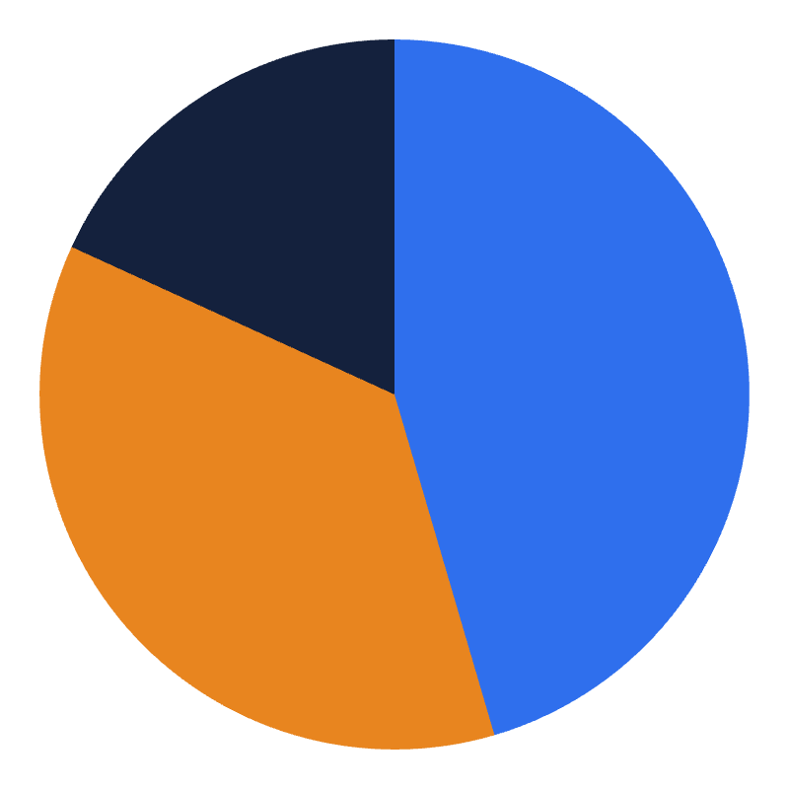
Pie chart and bar chart
PART 1 · GRAPHS
Pie chart
Bar chart: compare categories
5
4
2
Apple 45%
Banana 36%
Orange 18%
Apple
Banana
Orange
Part 1 · Graphs

Slide 32
Histogram: graph for numerical data
PART 1 · GRAPHS
Exam scores of 30 students
1. Group values into bins (score bands).
13
10
2. Count how many fall in each bin.
6
3. Draw a bar for each count. Bars touch.
1
Mode band: 80–89 (tallest bar)
60–69
70–79
80–89
90–99
Part 1 · Graphs
Notes:
A histogram looks like a bar chart but is for numerical data, so the bars touch and the bins follow a number line. Counts 1, 6, 13 and 10 add to 30 students. The tallest bar tells us where most scores fall. Contrast with the bar chart on the previous slide, which used categories.

Slide 33
Which summary would you use?
YOUR TURN · SUMMARIES · CLICK TO REVEAL EACH ANSWER
1
Number of students in each faculty
Bar chart or frequency table
2
How 250 people’s heights are spread
Histogram
3
Compare exam scores of two classes
Side-by-side boxplots
4
A typical value when data has outliers
Median
Part 3 · Summary pictures
Notes:
Reasoning to draw out: categories are counted and shown in a bar chart or frequency table; the shape of one numerical variable is a histogram; comparing groups is side-by-side boxplots; and when outliers are present the median is the safer centre than the mean.

Slide 34



What is AI?
PART 2 · ARTIFICIAL INTELLIGENCE
Artificial intelligence means computers doing tasks that normally need human intelligence.
Understand language
Recognise images
Make predictions
Read, answer and translate.
Spot faces, objects and text.
Forecast and recommend.
Notes:
Keep the definition simple: AI is software that does things we normally think need a human brain. It is not magic and it is not a robot; it is mostly programs that learn patterns. The three cards are the families of skills we will see in the next examples.

Slide 35
Definition of AI
“Intelligence: The ability to learn and solve problems”
– Webster’s Dictionary
“The science and engineering of making intelligent machines”
  McCarthy
“The study and design of intelligent agents, where an intelligent agent is a system that perceives its environment and takes actions to maximize its chances of success”
  Russel and Norvig AI book

Slide 36





AI in everyday life
PART 2 · ARTIFICIAL INTELLIGENCE
Maps
Recommendations
Face unlock
Best route and traffic
Videos, music, shopping
Your phone knows you
Spam filter
Weather apps
Fitness trackers
Sorts junk from real email
Smarter forecasts
Spot activity and sleep

Slide 37
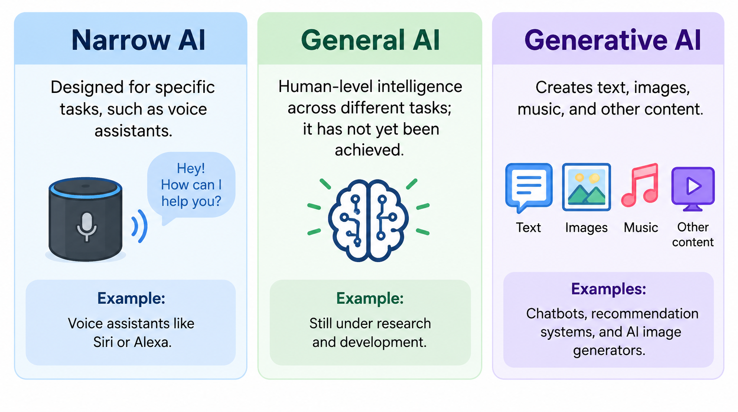
Types of AI

Slide 38
Advantages and Disadvantages
Advantages
Saves time and increases productivity.
Helps analyze large amounts of information.
Supports learning and problem-solving.
Disadvantages
Can produce incorrect information.
May create privacy and security risks.
Some jobs and skills may be affected by automation.

Slide 39
What is machine learning?
PART 3 · MACHINE LEARNING
Machine learning (ML) is a subfield of artificial intelligence (AI) that teaches computers to learn patterns from data and make decisions or predictions without needing explicit, hard-coded rules
Part 3 · Machine Learning
Notes:
Contrast the two rows. In traditional programming a human writes the rules. In machine learning we give examples (data plus the right answers) and the computer works out the rules, which we call a model. Example: instead of writing rules to spot spam, show it thousands of spam and non-spam emails.

Slide 40

What is machine learning?
PART 3 · MACHINE LEARNING
Traditional programming
Rules
+
Data
Answers
Machine learning
Data
Answers
Learned rules (model)
Machine learning means computers find the rules themselves by studying many examples.
Part 3 · Machine Learning

Slide 41
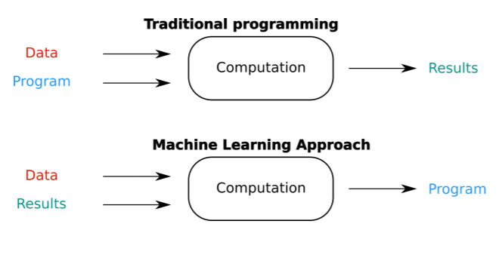
Traditional programming and Machine learning
PART 3 · MACHINE LEARNING
Part 3 · Machine Learning
Notes:
Traditional programming: You write a rule: If it rains, open an umbrella. You input the data: It is raining. The computer outputs: Open an umbrella.
Machine learning: You show the computer thousands of pictures of rain (data) paired with people holding umbrellas (results). The computer figures out the underlying rule (program) by itself.

Slide 42
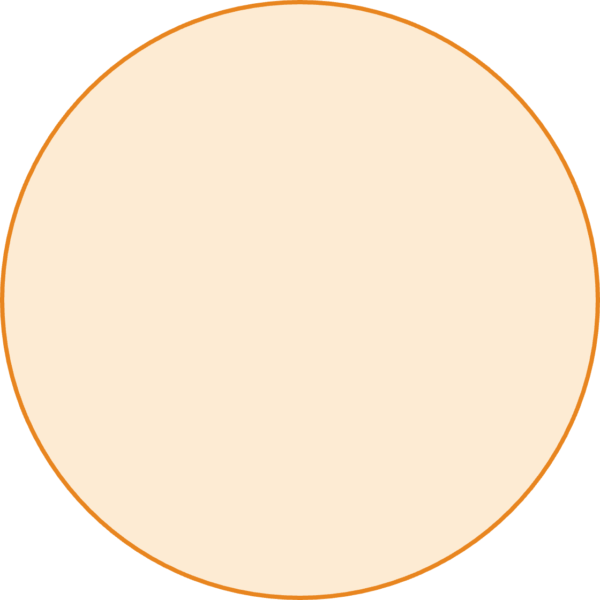
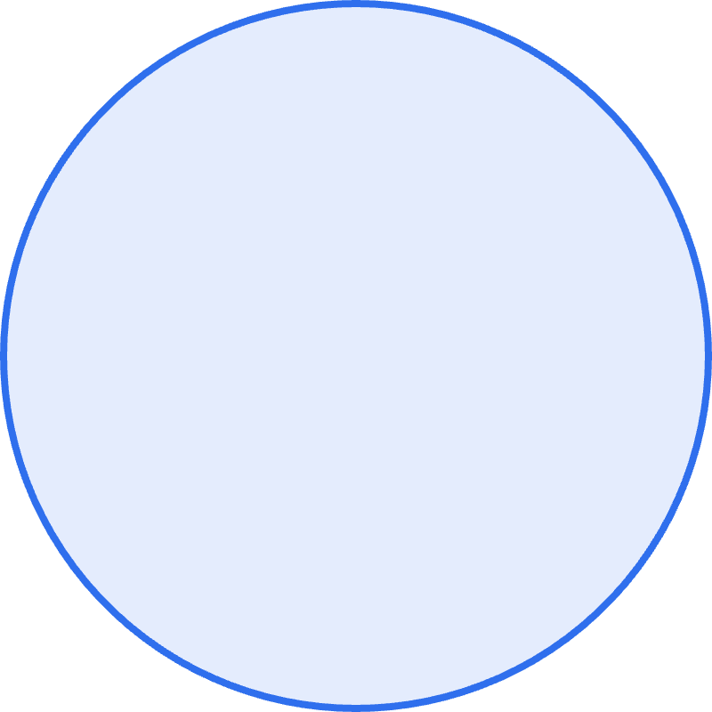

AI vs machine learning
PART 3 · MACHINE LEARNING
AI
AI is the big goal
Machines that act intelligently.
ML is one way to get there
Machine learning
Learn patterns from data instead of fixed rules.
Deep learning is a type of ML
Uses many-layered neural networks.
Deep learning
Part 3 · Machine Learning

Slide 43
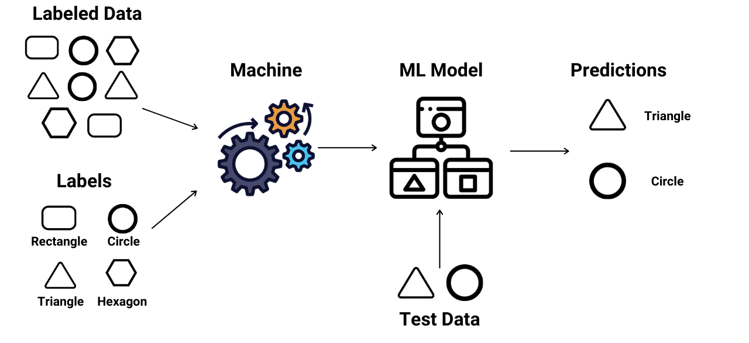
Supervised learning
PART 3 · MACHINE LEARNING
Supervised learning is a machine learning technique that uses labeled data sets to train artificial intelligence (AI) models to identify the underlying patterns and relationships. The goal of the learning process is to create a model that can predict correct outputs on new real-world data.
Part 3 · Machine Learning
Notes:
Supervised means there is a "supervisor" supplying the correct answers during training. Two flavours: classification predicts a category (spam or not), regression predicts a number (price, temperature). Ask the class for one more example of each.

Slide 44

Supervised learning
PART 3 · MACHINE LEARNING
Learning from examples that already have the right answer (a label).
EXAMPLE 1 ·
EXAMPLE 2 ·
Is this email spam?
What will this house cost?
Email text
Spam / Not spam
Size, area
A price
Predicts a category.
Predicts a number.
Part 3 · Machine Learning

Slide 45
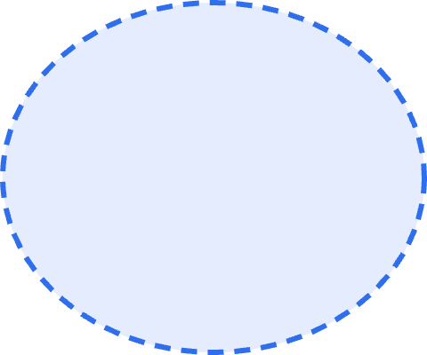

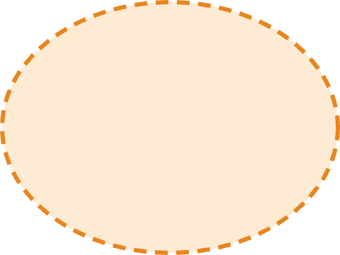
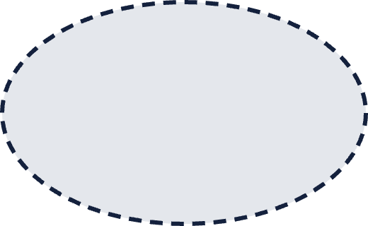

Unsupervised learning
PART 3 · MACHINE LEARNING
Learning from data with no answers given. The model looks for hidden groups and patterns.
EXAMPLE · CLUSTERING
Group A
Group shop customers by buying habits
Group B
Nobody tells the model what the groups are.
Group C
Supervised: answers given. Unsupervised: the model finds structure on its own.
Part 3 · Machine Learning
Notes:
The dots are customers; the colours are groups the algorithm discovered by itself. A shop could then send different offers to each group. Emphasise the contrast with the previous slide: there were labels there, here there are none.

Slide 46
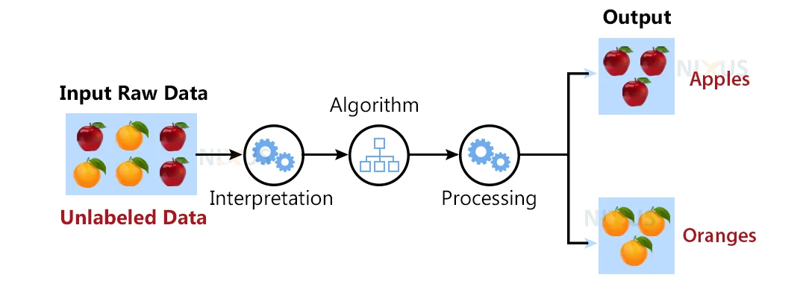
Unsupervised learning
PART 3 · MACHINE LEARNING
Unsupervised learning, also known as unsupervised machine learning, uses machine learning (ML) algorithms to analyze and cluster unlabeled data sets. These algorithms discover hidden patterns or data groupings without the need for human intervention.
Part 3 · Machine Learning

Slide 47
Statistics with NumPy
PART 4 · PYTHON · EXAMPLE 1
import numpy as np
marks = np.array([4, 6, 6, 8, 11])
print(np.mean(marks))
print(np.median(marks))
OUTPUT
7.0
6.0
Same answers as our hand calculation: mean 7, median 6.
Part 4 · Python
Notes:
Same marks as the earlier exercise: 4, 6, 6, 8, 11. One line creates the array, then np.mean and np.median give the answers instantly. Ask: what would change if we replaced 11 with 100? The mean jumps, the median stays the same. NumPy has no direct mode function, which is why we move to Pandas next.

Slide 48
Data tables with Pandas
PART 4 · PYTHON · EXAMPLE 2
import pandas as pd
df = pd.DataFrame({
"student": ["Ali", "Sam", "Zoya", "Omar", "Hina"],
"marks": [4, 6, 6, 8, 11]
})
print(df["marks"].mean()) # Mean: 7.0
print(df["marks"].mode()[0]) # Mode: 6
What df looks like
student | marks
Ali | 4
Sam | 6
Zoya | 6
Omar | 8
Hina | 11
Part 4 · Python
Notes:
A DataFrame is a table: each column is a list of values with a name. df["marks"] picks the marks column. The mode comes back as a list, so we take the first item with [0]. In real projects the table is usually loaded from a CSV file with pd.read_csv. Lines starting with # are comments for humans.

Slide 49
Spread and quartiles with NumPy
PART 4 · PYTHON · EXAMPLE 3
import numpy as np
X = np.array([2, 4, 5, 7, 9, 11, 12, 30])
print("Range:", np.max(X) - np.min(X))
print("SD:", np.std(X))
print("Q1:", np.percentile(X, 25))
print("Median:", np.percentile(X, 50))
print("Q3:", np.percentile(X, 75))
OUTPUT
Range: 28
SD: 8.215838362577491
Q1: 4.75
Median: 8.0
Q3: 11.25
Part 4 · Python
Notes:
Same eight numbers as the hand-worked summary. Range is 28. Sample SD is 8.78 (without ddof=1 NumPy gives 8.22, because it divides by n). Percentiles use linear interpolation so Q1 is 4.75 and Q3 is 11.25, close to our hand values of 4.5 and 11.5. Ask: what changes if we drop 30? The SD collapses.

Slide 50
Frequency tables with Pandas
PART 4 · PYTHON · EXAMPLE 4
import pandas as pd
fruit = ["apple", "apple", "banana", "orange",
"apple", "apple", "banana", "banana",
"orange", "banana", "apple"]
s = pd.Series(fruit)
print("Counts:")
print(s.value_counts())
print("Percentages:")
print(s.value_counts(normalize=True))
COUNTS
apple 5
banana 4
orange 2
PROPORTIONS
apple 0.4545
banana 0.3636
orange 0.1818
Part 4 · Python
Notes:
value_counts() is a Pandas method, so you need a Series or another suitable Pandas object:

